Slide 1

AstroSage: A Comprehensive Data-Driven Analysis
Exploring consultation patterns, revenue insights, and customer engagement in astrology services
By Deepshikha | September 21, 2025

Slide 2


Introduction to AstroSage
AstroSage is a leading digital platform offering comprehensive astrology services including horoscope matching, birth chart generation, and AI-powered astrological consultations. The platform serves as an essential tool for astrologers and individuals seeking guidance on life decisions.
With a diverse user base, AstroSage helps Hindus make important decisions about marriage, business ventures, and major life transitions. The platform combines traditional astrological wisdom with modern technology to deliver accessible guidance.
This analysis examines consultation patterns, revenue streams, and customer engagement metrics to provide actionable insights for strategic growth.

Slide 3




Data Overview
4 Consultation Services
149 Consultants
Comprehensive Dataset
Multiple channels for customer engagement
Expert astrologers available across platforms
Rich insights for analysis and forecasting
Strategic Insights
This comprehensive dataset enables deep analysis of operational costs, customer satisfaction metrics, and sales trends across consultation channels.
By examining historical patterns and performance indicators, we can predict future revenue opportunities and recommend strategic investments to drive sustainable growth in consultation services.

Slide 4
Methodology
01
02
03
Data Cleaning
Data Enrichment
Customer Segmentation
Applied spreadsheet functions including TRIM and duplicate removal to ensure data integrity and consistency across all records.
Enhanced dataset with calculated variables using date functions and derived metrics to enable multidimensional analysis.
Utilized sorting and filtering techniques to classify customers based on consultation type, enabling targeted analysis.
04
05
Performance Analysis
Visualization
Deployed pivot tables to analyze consultant performance across categories and examine rating distributions from user feedback.
Created an interactive dashboard with multiple chart types to provide comprehensive views of all key metrics and trends.

Slide 5
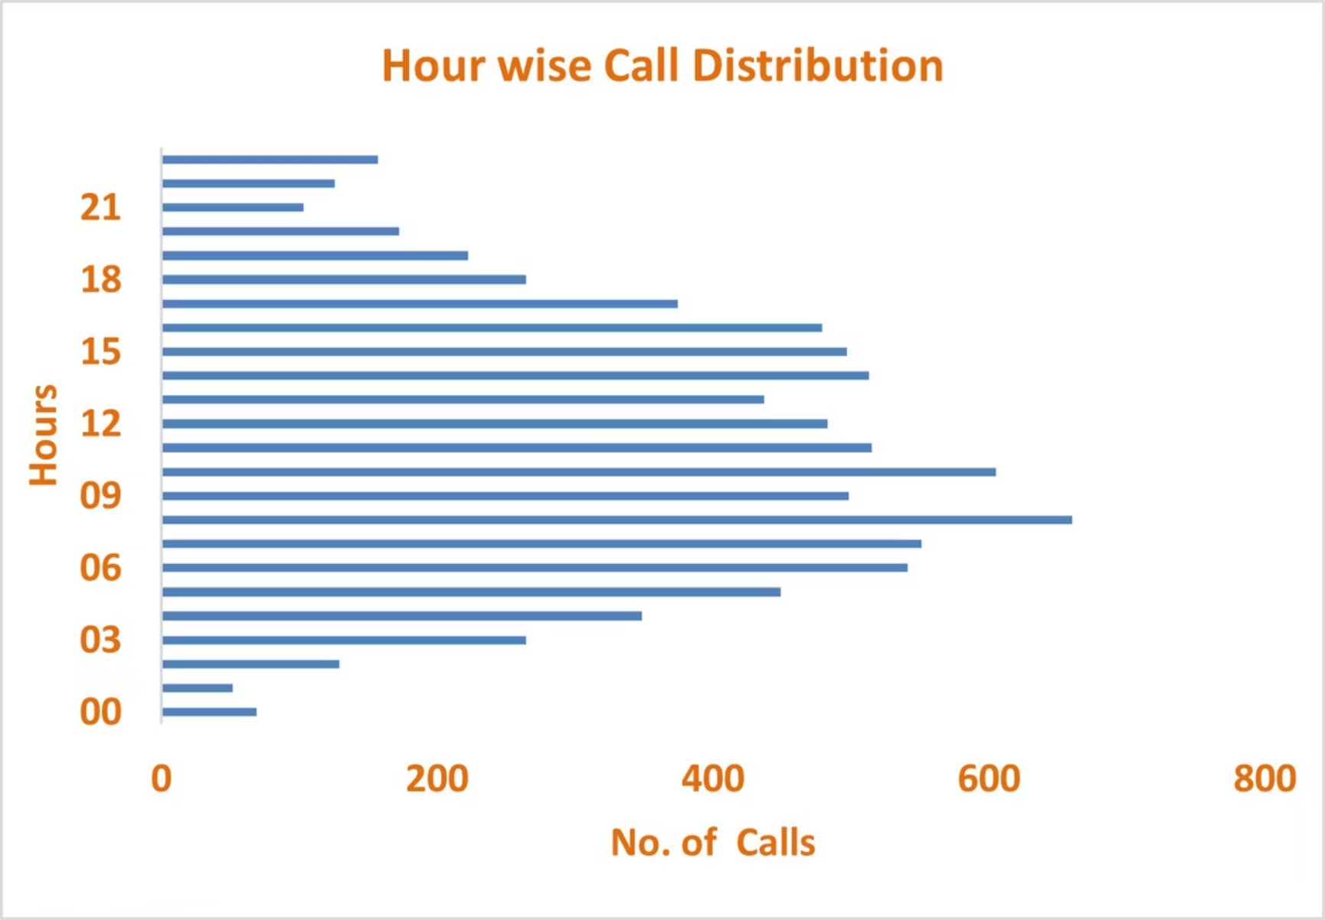
Hourly Call Distribution Patterns
Peak Activity Hours
660
10AM
Maximum Hourly Calls
Peak Period
Mid-morning concentration
Highest volume in a single hour
The analysis reveals distinct patterns in call distribution throughout the day, with mid-morning hours consistently receiving the highest volume of consultation requests. This insight is critical for resource allocation and staffing optimization.

Slide 6
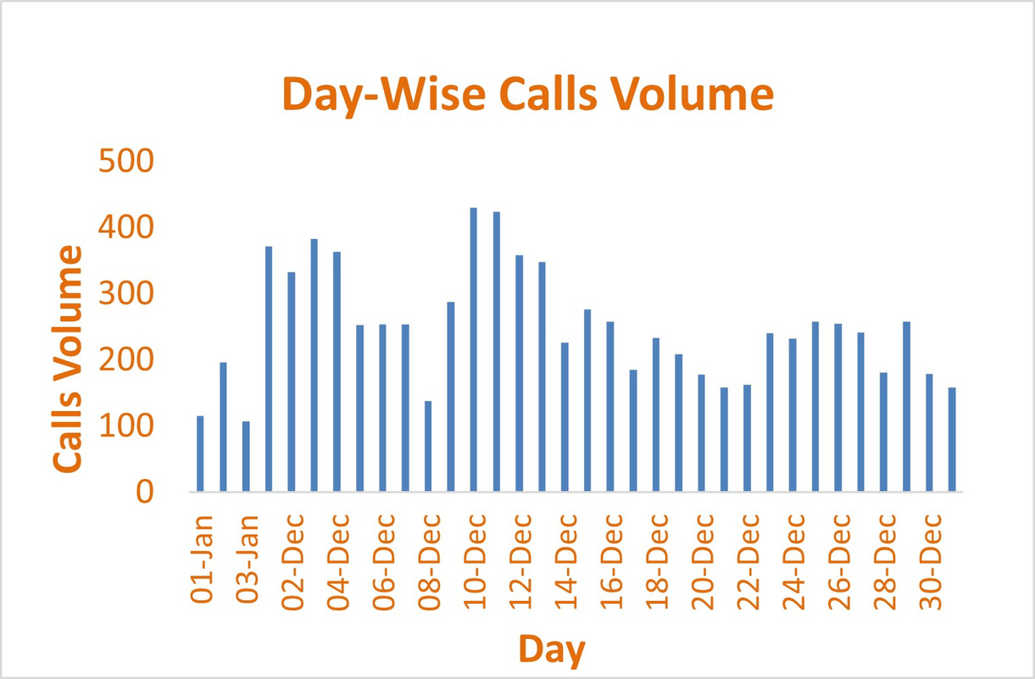
Daily Call Volume Analysis
Peak Daily Volume
Average Daily Performance
430 calls represents the maximum consultation volume recorded in a single day, indicating high-demand periods.
The call center maintains a consistent baseline of approximately 250 calls daily, demonstrating stable customer engagement.
Operational Implications
Understanding daily patterns enables better capacity planning and ensures adequate consultant availability during high-volume periods.

Slide 7
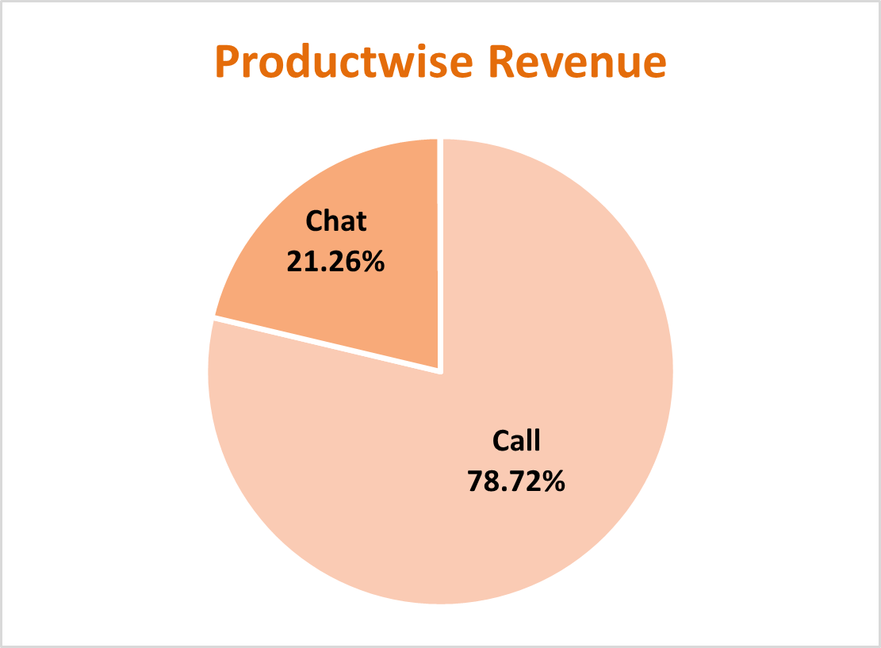

Revenue Distribution by Consultation Type
Key Revenue Insights
The product-wise revenue analysis reveals a detailed breakdown of income generated across different consultation formats. This data-driven perspective provides essential insights into which services drive the most value.
Call consultations emerge as the most profitable service, representing the primary revenue driver for AstroSage's business model. This finding suggests strategic priorities for marketing investment and consultant training programs.
Understanding the revenue contribution of each consultation type enables optimized resource allocation and targeted growth strategies across the platform.

Slide 8
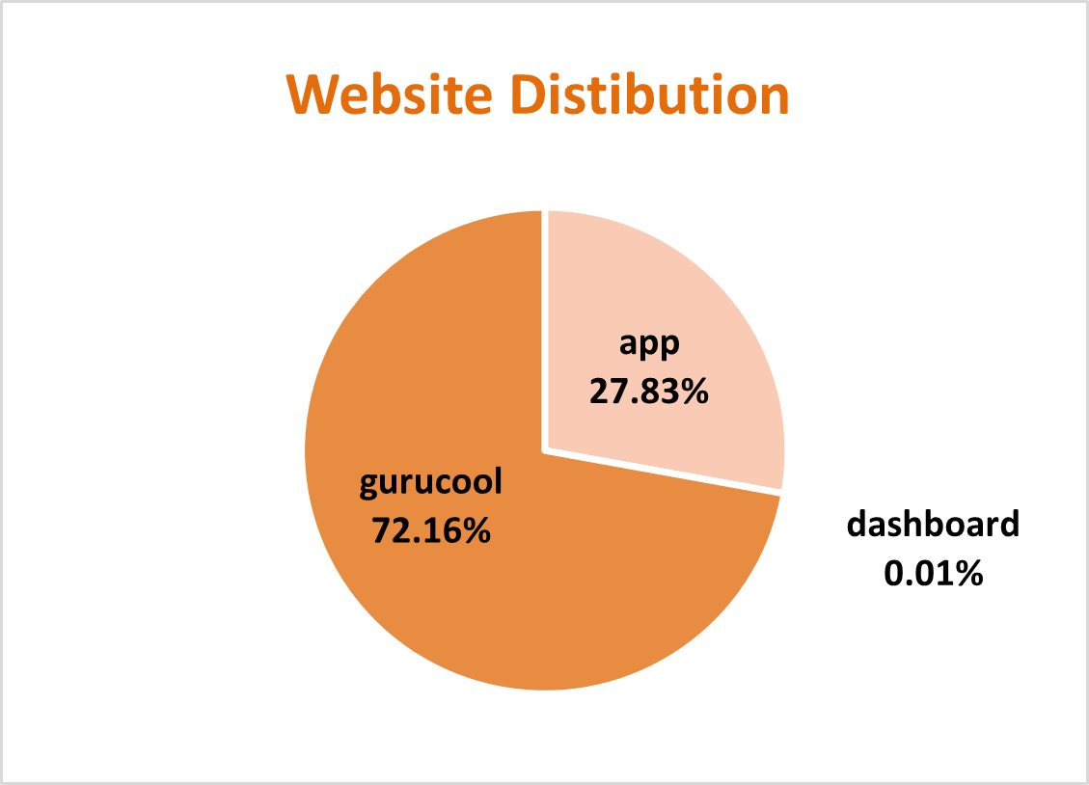

Website Channel Distribution
Channel Performance Analysis
Gurucool Dominance
The largest volume of consultations originates from the Gurucool platform, indicating strong brand presence and user engagement in this channel.
Dashboard Underperformance
The dashboard channel records the lowest consultation volume, suggesting potential opportunities for interface optimization or increased marketing focus.
Multi-Channel Strategy
Distribution across multiple websites demonstrates diversified customer acquisition, reducing dependency on any single platform.

Slide 9


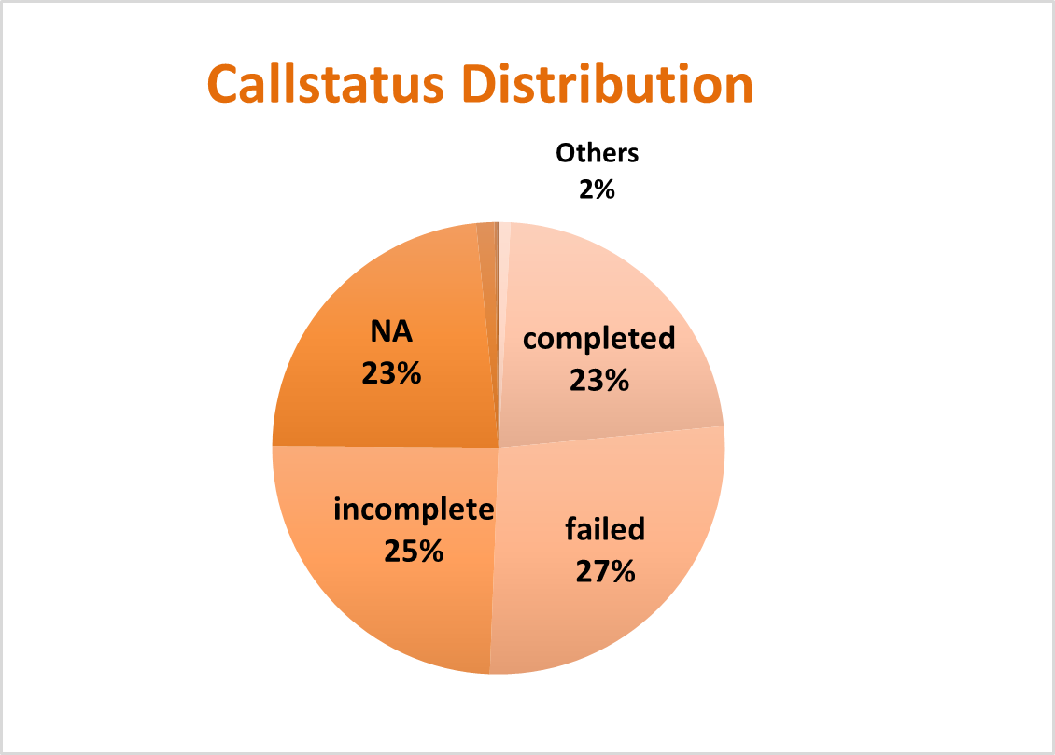
Call Status Breakdown
25%
50%
25%
Completed Calls
Failed Calls
Other Status (NA)
Successfully connected consultations
Highest proportion requiring attention
Non-call consultation types
Critical Findings
The call status analysis reveals a significant challenge: failed calls represent the largest segment, indicating potential issues with connectivity, availability, or technical infrastructure.
With only 25% of calls completing successfully, there's substantial opportunity to improve customer satisfaction and revenue capture by addressing technical barriers and optimizing the connection process.

Slide 10
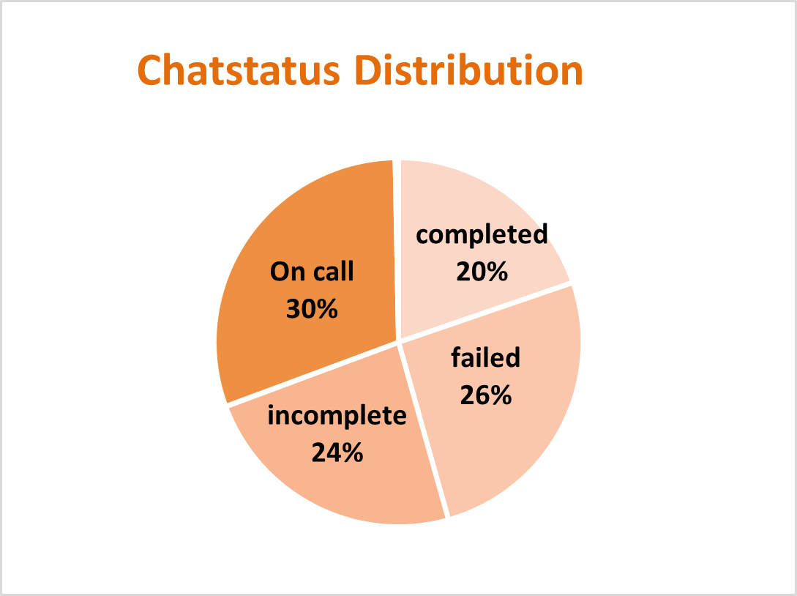
Chat Status Analysis
Chat Performance Metrics
20%
60%
Recommendation: Investigate technical barriers, consultant availability, and user experience factors contributing to high failure rates across both call and chat channels.
Completed Chats
Failed Chats
Successfully finished chat consultations
Largest segment indicating service challenges
20%
On Call Status
Alternative consultation formats
Similar to call patterns, chat consultations show a concerning failure rate, with the majority of attempted chats not completing successfully. This represents a critical area for operational improvement.

Slide 11
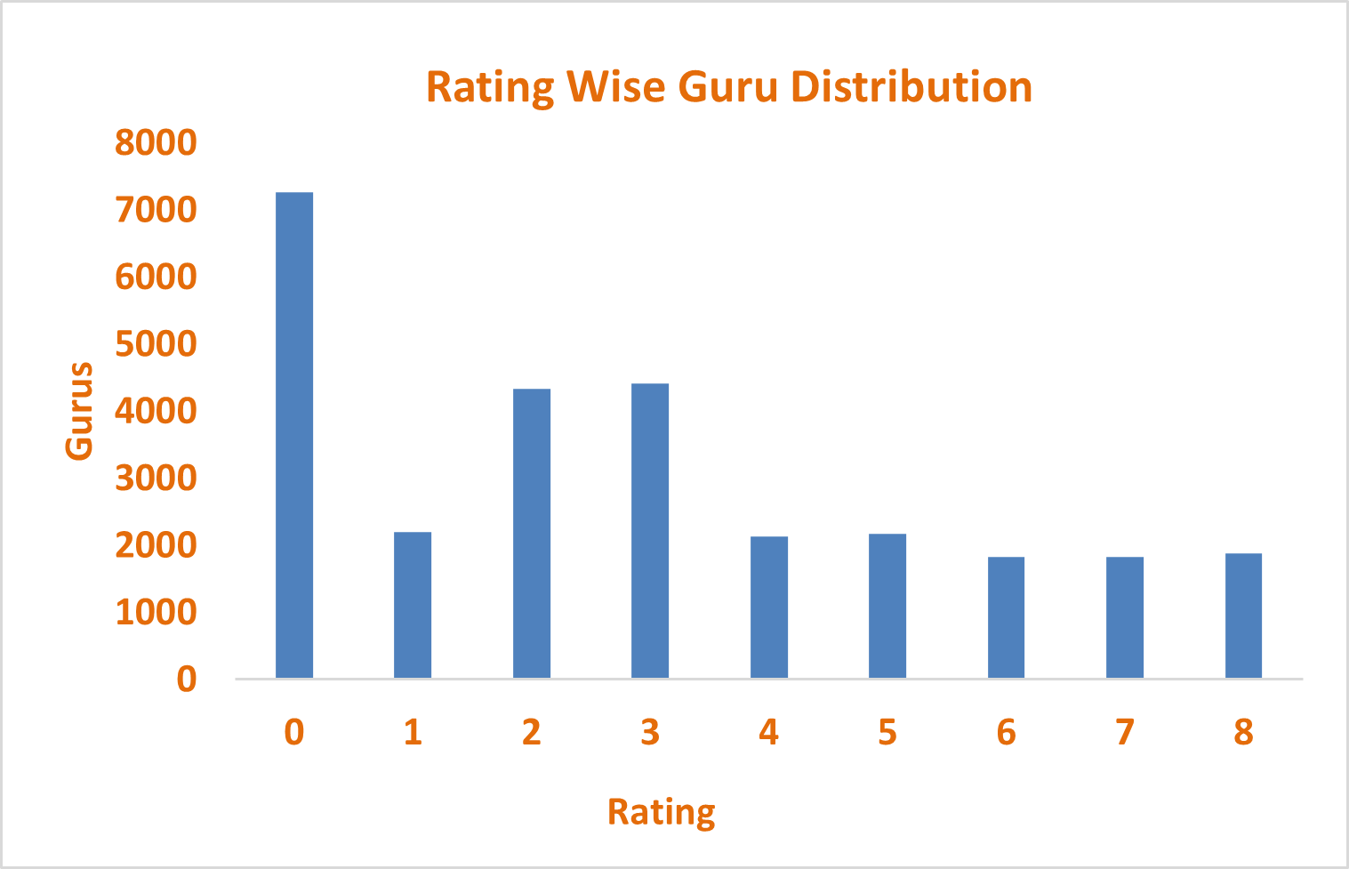

Guru Rating Distribution: Chat vs. Call
Key Insight: Chat Outperforms Calls
The rating-wise distribution reveals that gurus consulting via chat consistently achieve higher ratings compared to those conducting call consultations.
This performance gap suggests call consultations require targeted quality improvements and enhanced training protocols to match chat effectiveness.

Slide 12
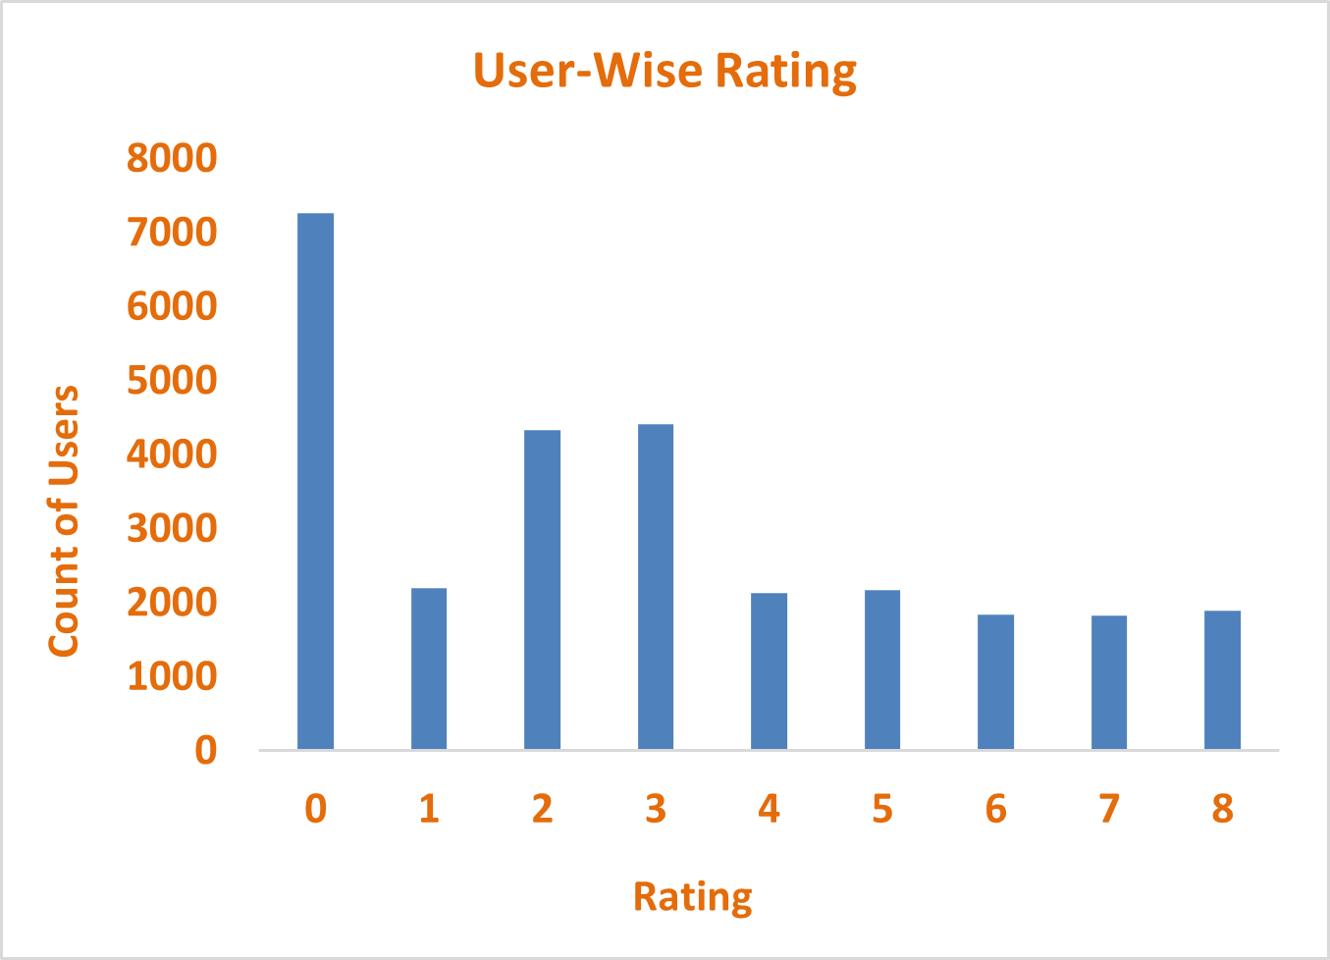

User Satisfaction: Channel Comparison
Chat Consultations
Users report higher satisfaction scores when consulting via chat, indicating better overall experience and quality.
Call Consultations
Call-based users show lower ratings, highlighting opportunities for service enhancement and process optimization.
Action Required: Implementing comprehensive training programs and quality assurance measures for call consultations will be critical to closing this satisfaction gap.

Slide 13

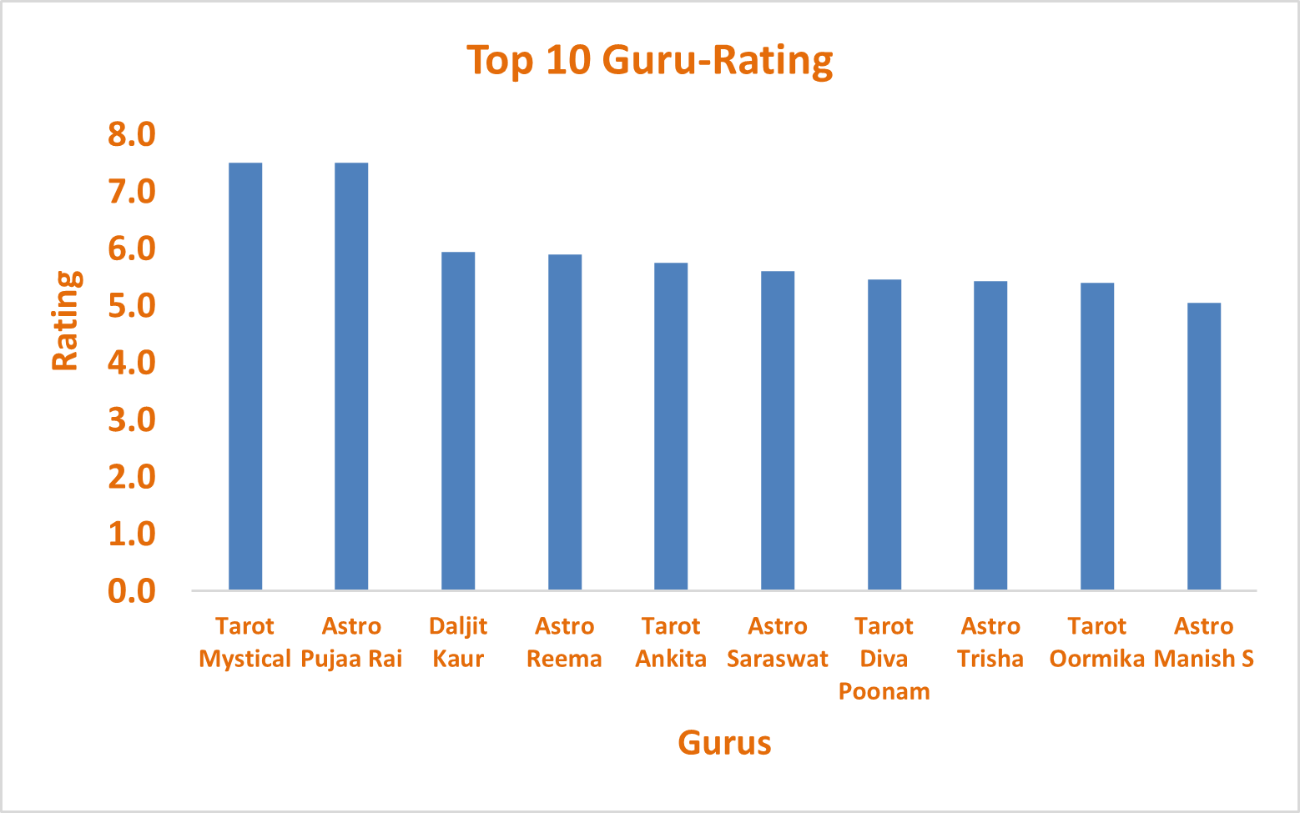
Top-Rated Gurus Performance
Excellence Leaders
Tarot Mystical and Astro Puja Rai lead with an impressive average rating of 7.5, setting the benchmark for consultation quality.
The top 10 gurus maintain a solid average rating of 5.5, demonstrating consistent quality across high-performing consultants.

Slide 14
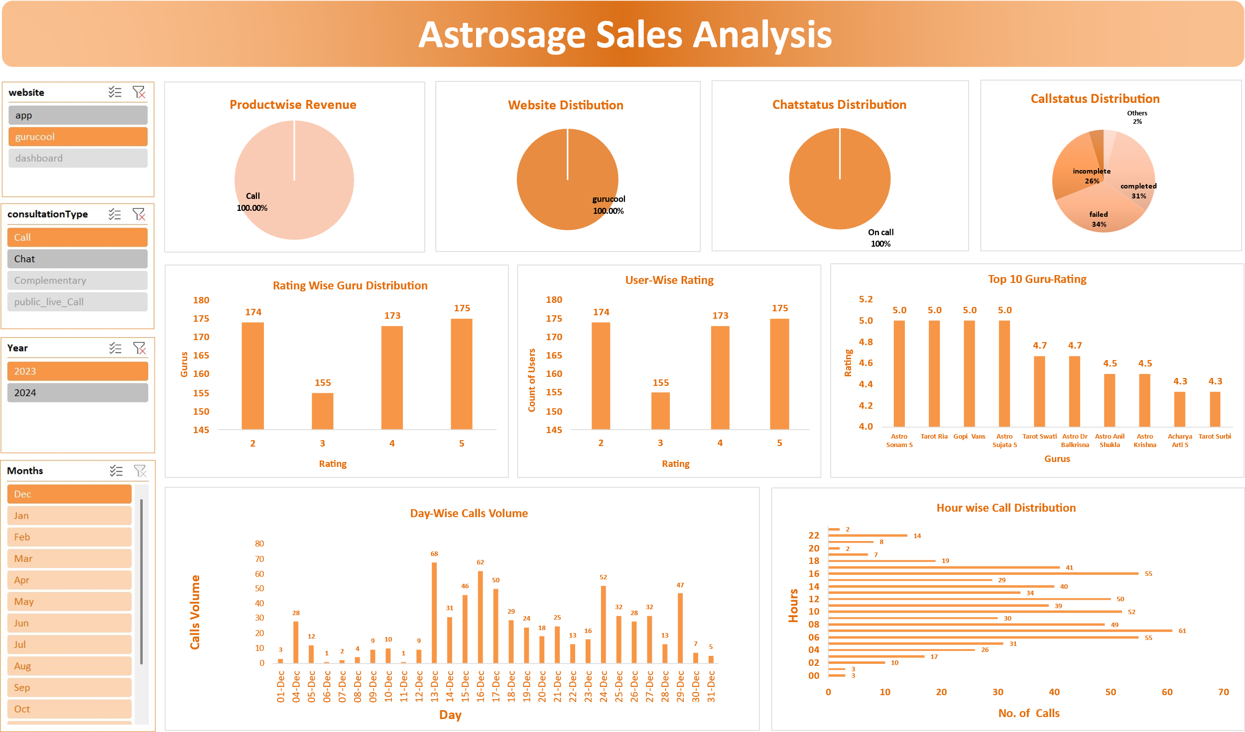

Slide 15
Comprehensive Dashboard Overview
01
02
Revenue Analytics
Dynamic Filtering
Consultation-wise revenue tracking with detailed breakdowns
Four slicers for website, consultation type, months, and year
03
04
Status Monitoring
Performance Metrics
Real-time call and chat status distribution across platforms
Guru ratings, user satisfaction, and hourly consultation patterns

Slide 16




Strategic Initiatives for Growth
Technology Enhancement
Upgrade platform infrastructure to increase app engagement and reduce cancelled or failed consultations, directly improving profitability and user retention.
Automation & Efficiency
Deploy chatbots and virtual assistants for general inquiries, reserving human consultants for peak hours and complex consultations to optimize operational costs.
CRM & Pre-Booking
Implement customer relationship management software with pre-booking capabilities, assigning dedicated consultants to clients for enhanced satisfaction and streamlined processes.
Quality Assurance
Enable customer choice of consultants, collect session feedback, and distribute top-rated recordings weekly for ongoing training to maintain consistency across all consultants.

Slide 17

Key Recommendations
Operational Excellence
Streamline operations through technology upgrades to reduce failed consultations and boost customer satisfaction
Revenue Growth
Focus on call consultations while implementing chatbots for routine queries to increase revenue and reduce costs
Customer Empowerment
Allow consultant selection and gather feedback to build trust and strengthen customer loyalty
Efficiency Gains
Deploy pre-booking and CRM systems to eliminate repetitive intro sessions and improve workflow

Slide 18


Path Forward: Quality & Consistency
Recognition Program
Call Quality Focus
Acknowledge top consultants and share best practices through weekly recording distribution
Implement improved training models for call consultations to reduce session time while increasing satisfaction
1
2
3
4
Training Enhancement
Cost Optimization
Organize regular training sessions to maintain service quality and keep all consultants current
Achieve better efficiency and reduced operational costs through strategic improvements
Critical Focus: Call center training must prioritize consultation completion speed while maintaining quality, ultimately driving better ratings and customer experience.

Slide 19
Thank You
Questions and discussion

